Slide 1
Housing Affordability Near Metro’s Light Rail – Expo Line & Gold Line
Michelle Ramirez
A Thesis Presented to the
Faculty of the USC Graduate School
University of Southern California
In Partial Fulfillment of the Requirements for
the Degree Master of Science
(Geographic Information Science and Technology)
December 2019

Slide 2
Research Goals and Objectives
How has the development of the Metro’s light rail lines (Expo & Gold) influenced the value of housing within a .5 mile proximity of the light rail stations over the last 10 years? And has the development of these lines change the demographics and the physical layout?
Outcomes:
Regression models that illustrate the correlation between the Metro’s light rail lines and values of housing
A series of maps that would illustrate the 10 year period of change in each of the neighborhoods that will be studied
Average median income
Different demographics and change overtime
The change in zoned areas
SECTION TITLE | 2

Slide 3
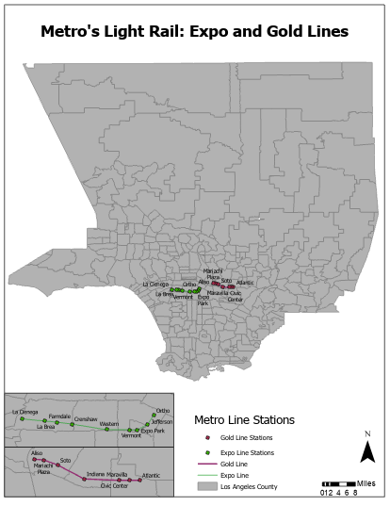
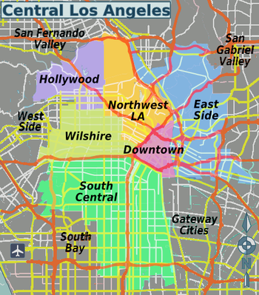
Study Area
East Los Angeles & South Los Angeles
.5 miles from Metro Light Rail Stations

Slide 4

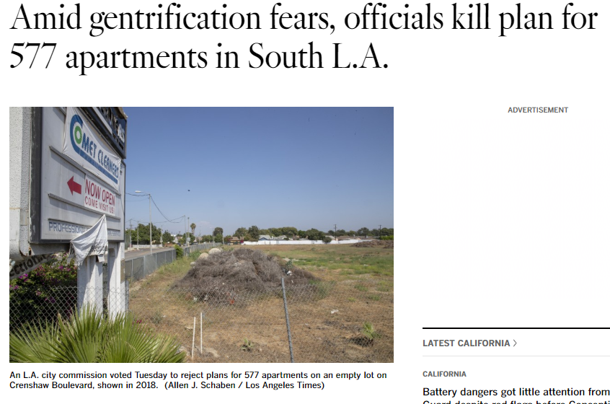
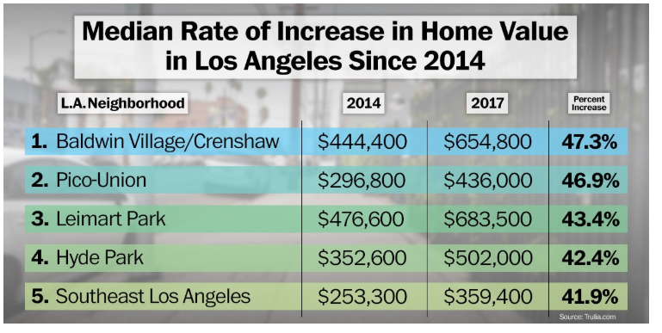

Motivation
Rising housing values and rent prices
Increased displacement
Inform stakeholders

Slide 5
Background Research
Related Work
Who has housing affordability problems? Disparities in housing cost burden by race, nativity, and legal status in Los Angeles by Eileen McConnell
Measuring the impact of light rail systems on single family home values: A hedonic approach with GIS application by Anthony Chen et al.
The Impact of Transit-oriented Development on Housing Prices in San Diego, CA by Michael Duncan

Slide 6
Background Research
Metro’s Light Rail Line | Origin of dataset or source: Metro Developer GIS data (Free) Updated: December 2018 The data is accurate and precise with all the light rails representing the current locations of each rail. This data will be considered as a spatial scale because it extends all of Los Angeles County.
Assessor Parcels Data - 2006 thru 2019 | This dataset was downloaded from the County of Los Angeles Open Data website. (Free) This dataset was download as a CSV file and the data was created in 2006 and has had data updated up to 2018. This data can be both temporal and spatial scale, but I will use it as temporal scale to depict the change in housing value.
US Census | The dataset for this line is represented by as a raster data. I still need to look and find this data. This will come from the US Census, City or County website. This data can be both temporal and spatial scale, but I will use it as temporal scale to depict the change in time for demographics.
Zoned Land | Comes from Los Angeles County GIS Data Portal The dataset is parcel data for the last 10 years This data will be both temporal and spatial scale which will be depicted on the maps
DATA
Utilize a .5 mile buffer to study housing, demographics, and income within that buffer
Utilize the dependent and independent variables to determine if there is a correlation between the light rails and housing prices
Utilize income and race as indicators for displacement

Slide 7
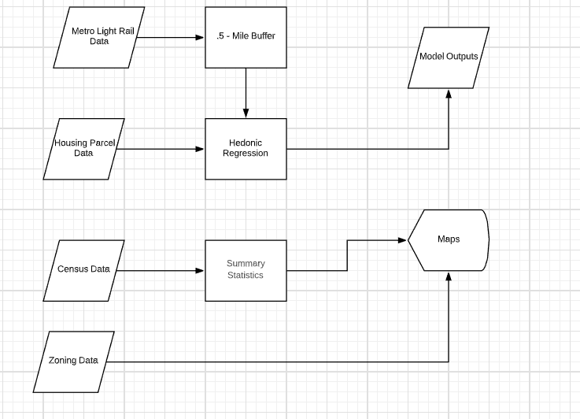
Workflow Design

Slide 8
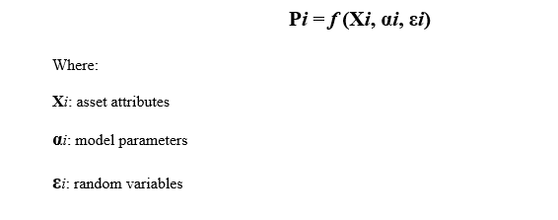
Methodology
Hedonic Regression Model
(Xi) total value in the dataset – the housing structure and land value
(αi) year built, sqft, bedrooms, bathrooms, land value, and miles to the light rail
(εi) were not taken into consideration like noise, parks, or air pollution.

Slide 9
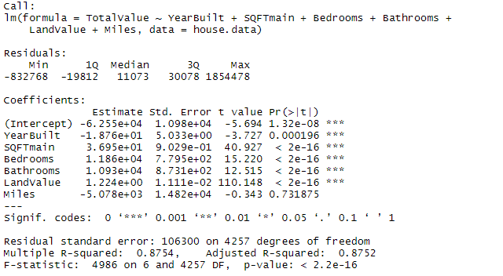
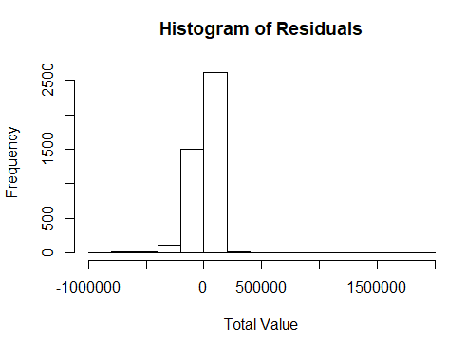
Findings – South Los Angeles

Slide 10
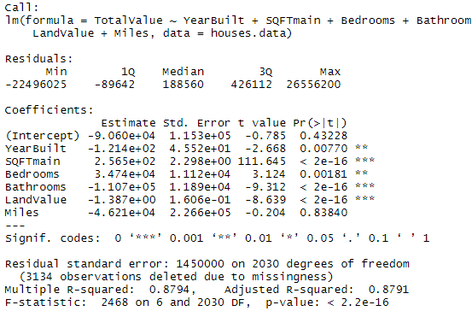
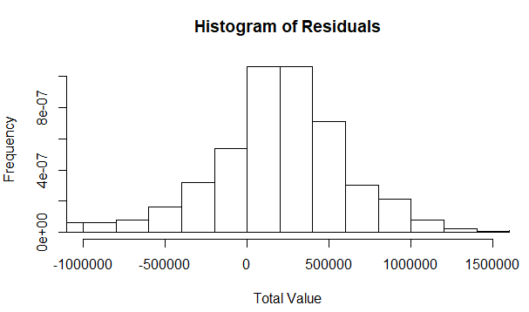
Findings – East Los Angeles

Slide 11
Methodology
Thematic Maps
Choropleth map
Percentage of Change
Ordnance or Zone Map
Change in code

Slide 12
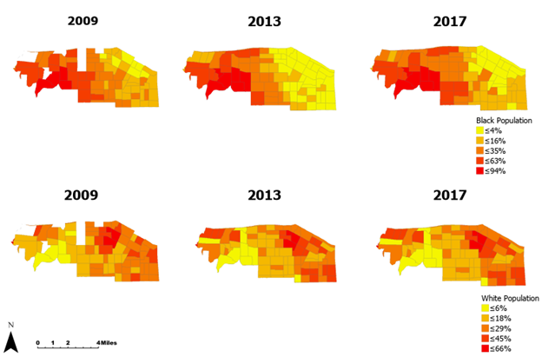
Findings- South Los Angeles

Slide 13
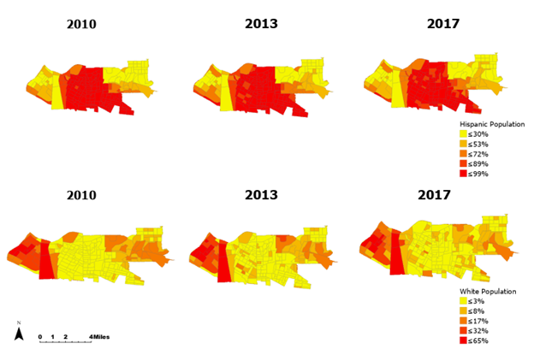
Findings – East Los Angeles

Slide 14
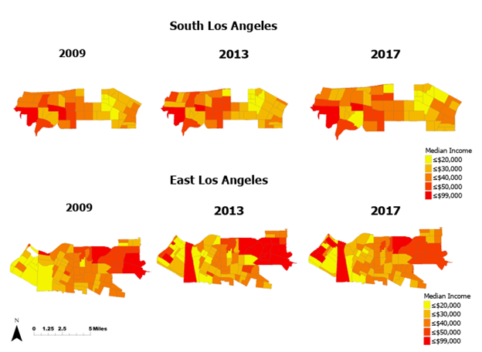
Findings - Income

Slide 15
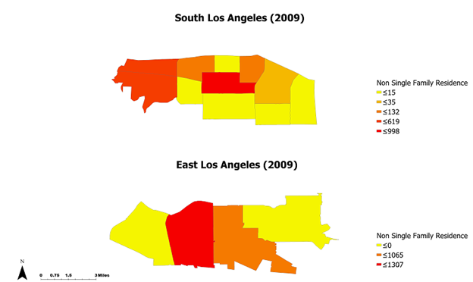
Findings – Zone Types Non-Single Family Homes

Slide 16
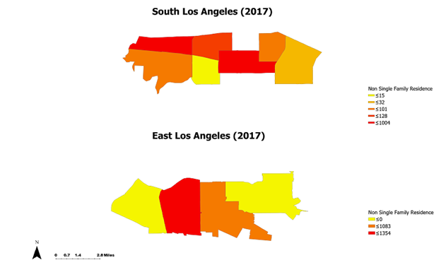
Findings – Zone Types Non-Single Family Homes

Slide 17
Conclusion and Recommendations
Working hypothesis was in-corrected and the data did not yield results
Study can be improved on with time and more data regarding these two areas

Slide 18
Questions or Comments?

